Slide 1


Create an R Project using Version Control
BEFORE WE START!
2. Select your directory and add the following Git Repository URL:
https://github.com/ncypris/power_sim.git
3. All the files you need will be downloaded into your Project directory,
including these slides!

Slide 2
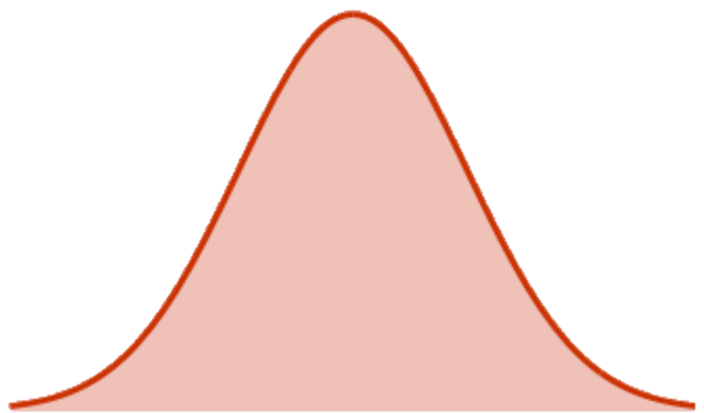



JRP WORKSHOP – 21/02/2021 Power Simulations: Going beyond G Power
Daniel Toribio-Flórez
Niklas Cypris

Slide 3








Time for Introductions!
Niklas Cypris
Background:
1st-year PhD student at Max Planck Institute for Research on Collective Goods (Bonn, Germany)
M.Sc. & B.Sc. in Psychology at University of Cologne (Germany)
Research interests:
Hate Speech & Misinformation
Social Identity & Morality
Open Science
Moral Courage Research Group
Daniel Toribio-Flórez
Background:
4th-year PhD student at Max Planck Institute for Research on Collective Goods (Bonn, Germany)
MRes in Social Psychology at Vrije Universiteit Amsterdam (Netherlands)
BSc in Psychology at Universidad Autónoma de Madrid (Spain)
Research interests:
Moral Courage and Intervention Behavior
Attitudes and Attitutinal Ambivalence
Open Science!

Slide 4
Overview
Theoretical Part:
Basics in Statistical Power and how to assess it! (≈ 15min)
The Logic of Power Simulation (≈ 15min)
Practical Part
Exercise 1: Your First Simulation! (≈ 30min)
Exercise 2: Power Simulation for one real study! (≈ 30min)
Q&A

Slide 5
Basics in Statistical Power and how to assess it!

Slide 6



Goal of Inferential Statistics

Slide 7
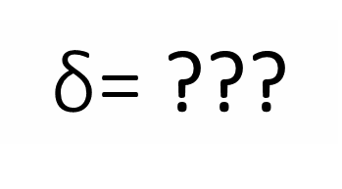
Goal of Inferential Statistics
$\text{δ}$= ???
d = .40
Notes:
We obtain data of a random sample from our target population.
We observe a specific effect of a given size.
Based on this effect size, we aim to make a generalization about the population.

Slide 8
Two states of the world…
Our effect is FALSE at the population level
AVOID FALSE POSITIVES!
α = .05
Notes:
If we assume that our effect is false in the population, our main concern is to avoid false positives.
We control for this possibility by conventionally establishing α = .05.

Slide 9
Two states of the world…
Our effect is FALSE at the population level
AVOID FALSE POSITIVES!
α = .05
Notes:
Therefore, if we conducted 100 studies, only 5 would show a significant result.

Slide 10
Two states of the world…
Our effect is FALSE at the population level
AVOID FALSE POSITIVES!
Our effect is TRUE at the population level
AVOID FALSE NEGATIVES!
α = .05
1 - β = .80
Notes:
If we assume that our effect is true in the population, our main concern is to avoid false negatives.

Slide 11
Two states of the world…
Our effect is FALSE at the population level
AVOID FALSE POSITIVES!
Our effect is TRUE at the population level
AVOID FALSE NEGATIVES!
α = .05
1 - β = .80
Notes:
With the conventional level of statistical power at .80, we would expect that from the 100 studies, 20 should show a false negative.

Slide 12
Why more control over False Positives versus False Negatives?
AVOID FALSE POSITIVES!
AVOID FALSE NEGATIVES!
α = .05
1 - β = .80
Notes:
And now, question:
Why do we have this discrepancy in the control over false positives versus false negatives?

Slide 13
Why more control over False Positives versus False Negatives?
AVOID FALSE POSITIVES!
AVOID FALSE NEGATIVES!
For science, false positives are four times worse
than false negatives.
Neyman & Pearson (1933)
α = .05
1 - β = .80
Notes:
As many other things in applied statistics, it comes from a convention. This convention is based on the claim by Neyman and Person that for science false positives are four times worse than false negatives.
The problem with this convention is not only that false negatives can also be as problematic as a function of the field, the application or implications of the results, etc…

Slide 14
AVOID FALSE NEGATIVES, AND INCREASE TRUE POSITIVES!
AVOID FALSE POSITIVES!
AVOID FALSE NEGATIVES!
α = .05
1 - β = .80
Notes:
The main problem is that it focuses the question on the AVOIDANCE OF FALSE NEGATIVES, but leaves aside the importance of increasing the probability of TRUE POSITIVES.

Slide 15
AVOID FALSE NEGATIVES, AND INCREASE TRUE POSITIVES!
AVOID FALSE POSITIVES!
α = .05
1 - β = .95
Notes:
If we assume that our effect is true in the population, our main concern is to avoid false negatives.
The main problem is that it focuses the question on the AVOIDANCE OF FALSE NEGATIVES, but leaves aside the importance of increasing the probability of TRUE POSITIVES.

Slide 16

Why is important to increase the probability of TRUE POSITIVES?
Our effect is FALSE at the population level
Our effect is TRUE at the population level
p < .05
AVOID
FALSE POSITIVES
BE ABLE TO DETECT
TRUE POSITIVES
Notes:
If the truth about a null hypothesis is unknown, then given that “false positives” naturally occur (problems with randomization, measurement error, etc.), it is critical that “true positives” also be detected, ideally in far greater quantities.
In fact, when power is low, any significant results obtained are more likely to be false positives, owing to the low probability of “true” positives (Ioannidis, 2005).

Slide 17
What does Statistical Power depend on?
Effect
Size
d for t-test,
rho (ρ) for correlation,
η_{p}² for ANOVA…
α
Usually α = .05
1 - β
Sample
Size (N)
Between-Subject Design
(i.e., number of participants)
Within-Subject Design
(i.e., number of observations)
Notes:
Others: Complex multivariate models may require other parameters such as correlations among variables.

Slide 18
Ways of Assessing Statistical Power
A PRIORI
POWER ANALYSIS
SENSITIVITY ANALYSIS
POWER-DETERMINATION ANALYSIS
INPUT:
Effect Size
Alpha
Desired Power
OUTPUT:
Sample Size
INPUT:
Sample Size
Alpha
Desired Power
OUTPUT:
(Minimum) Effect Size
INPUT:
Effect Size
Sample Size
Alpha
OUTPUT:
Estimated Power
Notes:
When estimating power from collected data, the power estimate is uninformative, because it is a monotonic function of the p-value. In other words, it is just a transformation of the p-value (<.001 = > 99% power, etc.; Goodman & Berlin, 1994).
Post-hoc power analysis should be based on an independently derived effect size. Or, post-hoc analysis outputting minimum detectable effect
size from power and N (“sensitivity analysis” in G*Power).

Slide 19
When can we assess Statistical Power?
BEFORE
AFTER
A PRIORI
POWER ANALYSIS
DATA COLLECTION
SENSITIVITY ANALYSIS
SENSITIVITY ANALYSIS
POWER-DETERMINATION ANALYSIS
POWER-DETERMINATION ANALYSIS
Notes:
Example from Giner-Sorolla et al. (2020):
A researcher might begin a priori, determining sample size necessary to detect the effect size of interest (e.g., N = 788 for 80% power to detect d = 0.20 in an independent samples t-test). Using this example, they might then realize that N = 788 is unrealistic, because 500 is the maximum sample size achievable with current funding. Power-determination analysis then reveals that only 61% power is achieved for N = 500 and d = 0.20. Begrudgingly, the researcher gives up on detecting such small effects, but what effect sizes can be detected with n = 500? An effect-size sensitivity analysis reveals that d = 0.25 can be detected with 80% power. The researcher might decide this is close enough to the intended effect size, and proceed to gather 500 participants.

Slide 20
When can we Assess Statistical Power?
BEFORE DATA COLLECTION
A PRIORI
POWER ANALYSIS
d = .20, α = .05, 1 – β = .80
N = 788
POWER-DETERMINATION ANALYSIS
d = .20, α = .05, N = 500
1 – β = .61
SENSITIVITY ANALYSIS
α = .05, N = 500, 1 – β = .80
d = .25
Notes:
Example from Giner-Sorolla et al. (2020):
A researcher might begin a priori, determining sample size necessary to detect the effect size of interest (e.g., N = 788 for 80% power to detect d = 0.20 in an independent samples t-test). Using this example, they might then realize that N = 788 is unrealistic, because 500 is the maximum sample size achievable with current funding. Power-determination analysis then reveals that only 61% power is achieved for N = 500 and d = 0.20. Begrudgingly, the researcher gives up on detecting such small effects, but what effect sizes can be detected with n = 500? An effect-size sensitivity analysis reveals that d = 0.25 can be detected with 80% power. The researcher might decide this is close enough to the intended effect size, and proceed to gather 500 participants.

Slide 21
The Logic of Power Simulations

Slide 22
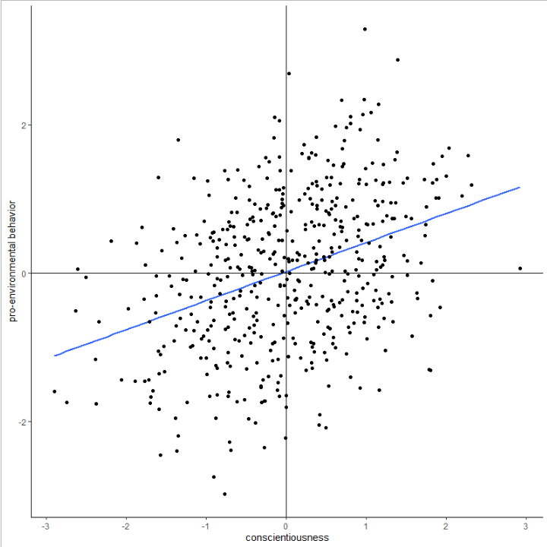
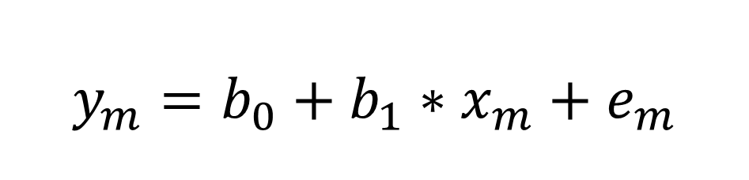
Regression Equation
$$y_{m}=b_{0}+b_{1}∗x_{m}+e_{m}$$

Slide 23
Regression Equation
$$y_{m}=b_{0}+b_{1}∗x_{m}+e_{m}$$

Slide 24
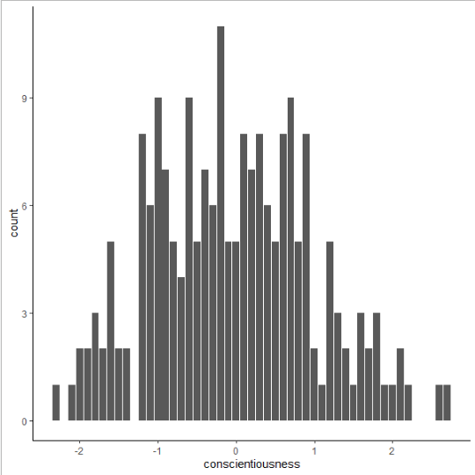
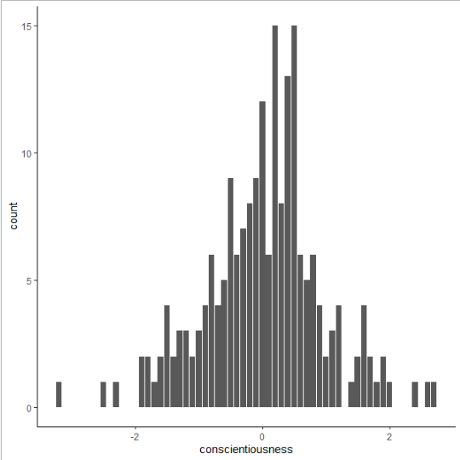
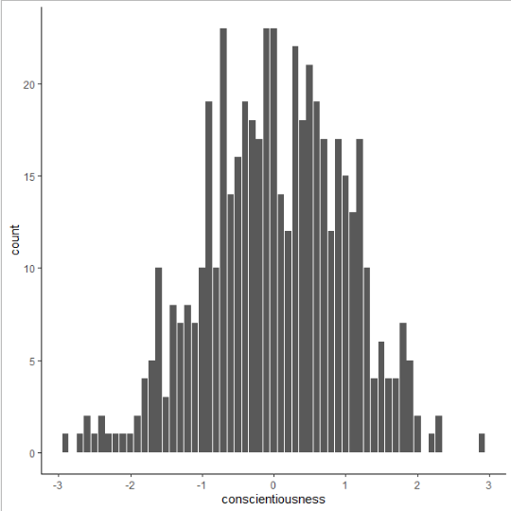
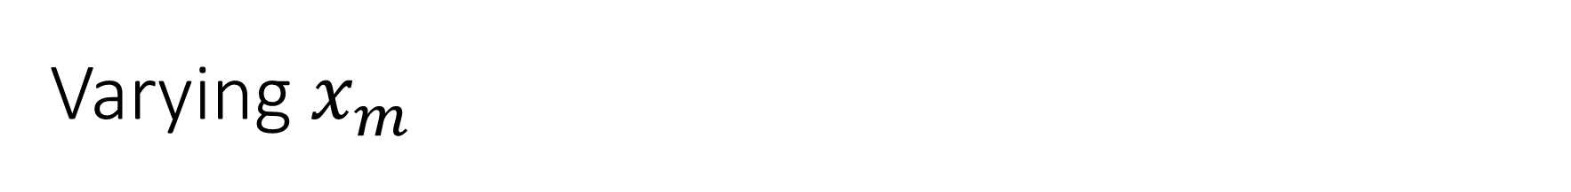
Varying $x_{m}$

Slide 25
Regression Equation
$$y_{m}=b_{0}+b_{1}∗x_{m}+e_{m}$$

Slide 26
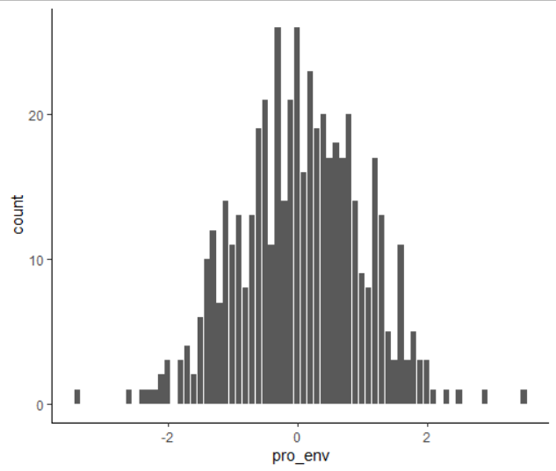
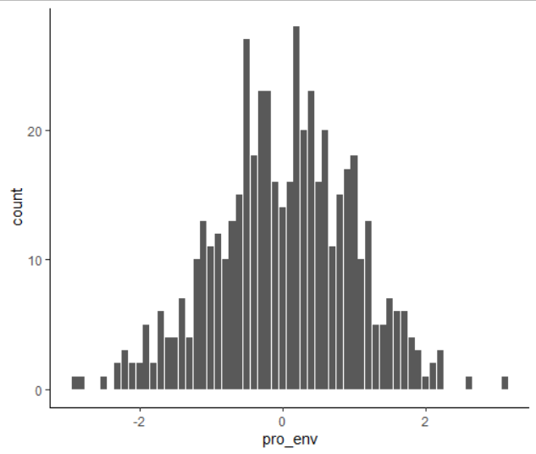
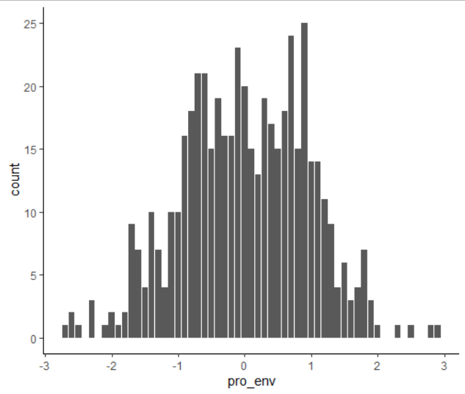

Varying $e_{m}$

Slide 27
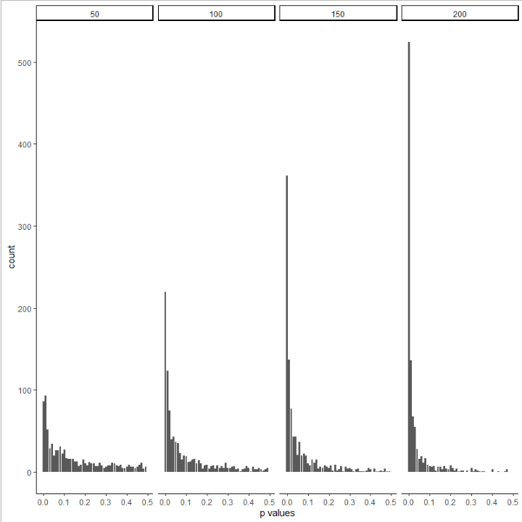
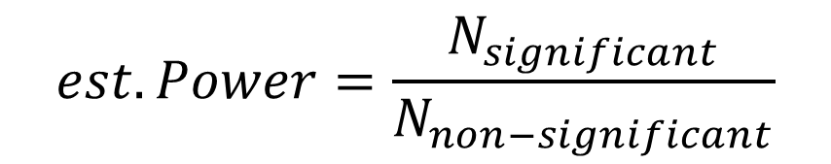
Lots of simulations
$$est. Power=\frac{N_{significant}}{N_{non−significant}}$$
0.30
0.52
0.67
0.82

Slide 28
Exercise 1: Your First Simulation!

Slide 29
Exercise 2: Power Simulation for one real study!

Slide 30
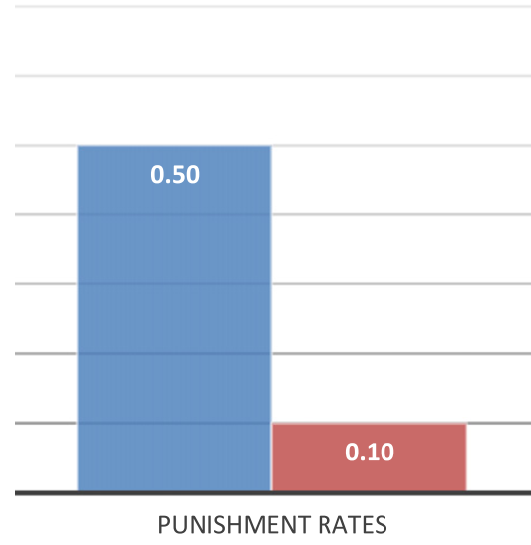

Background Information Balafoutas et al. (2014)
Punishment rates significantly decrease in the presence of counterpunishment.
Fisher’s exact test, two-tailed, p-value < 0.001
Is Balafoutas et al.´s analysis sufficiently powered?
Can we use their sample size for our research purposes?
If not, which sample size should we aim for?

Slide 31
Q&A

Slide 32
References and Resources:
Some references on Statistical Power:
Neyman, J., & Pearson, E. S. (1933, October). The testing of statistical hypotheses in relation to probabilities a priori. In Mathematical Proceedings of the Cambridge Philosophical Society (Vol. 29, No. 4, pp. 492-510). Cambridge University Press.
Giner-Sorolla, R., Carpenter, T., Lewis, N. A.,… Sodesberg, C. (2020). Power to Detect What? Considerations for Planning and Evaluating Sample Size. OSF. https://osf.io/d3v8t/
R packages Tutorials:
Paramtest: https://cran.r-project.org/web/packages/paramtest/vignettes/Simulating-Power.html
Power Simulations with Multilevel Models:
DeBruine, L. M., & Barr, D. J. (2019). Understanding mixed effects models through data simulation. PsyArxiv. https://doi.org/10.31234/osf.io/xp5cy
Green, P., & MacLeod, C. J. (2015) SIMR: an R package for power analysis of generalized linear mixed models by simulation. Methods in Ecology and Evolution. Vol. 7, No. 4, pp-493-498. https://doi.org/10.1111/2041-210X.12504
Power Simulations with Structural Equation Modelling (e.g., Mediational Analyses):
Wang, Y. A., & Rhemtulla, M. (2020). Power analysis for parameter estimation in structural equation modeling: A discussion and tutorial. PsyArxiv. https://doi.org/10.31234/osf.io/pj67b

Slide 33
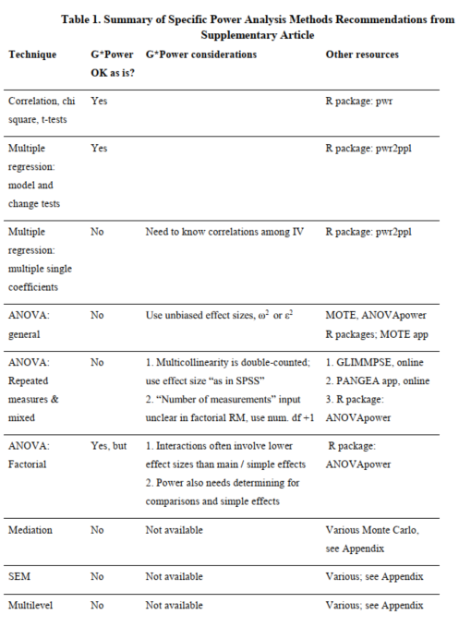
Giner-Sorolla, R., et al.(2020)

Slide 34

Thank you for attending today!
@
@
toribio-florez@coll.mpg.de
@dtoribio8
cypris@coll.mpg.de
@ncypris

